Slide 1
Sect 7.4 What is a Logarithm? Basic Logarithm Rules
© Copyright all rights reserved to Homework depot: www.BCMath.ca

Slide 2
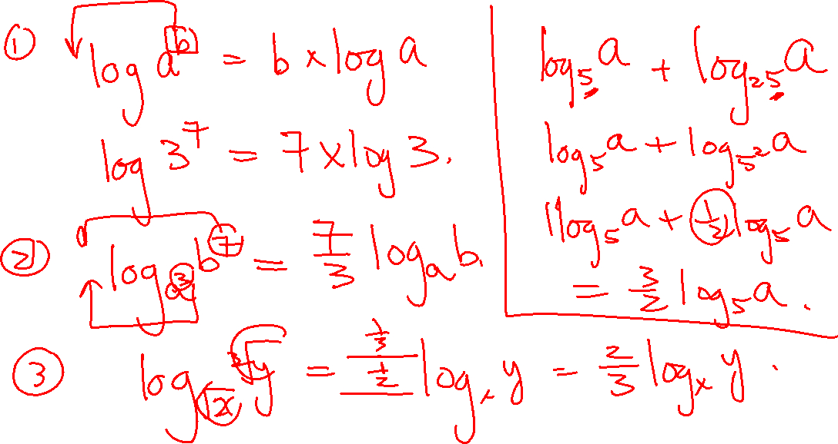

Slide 3
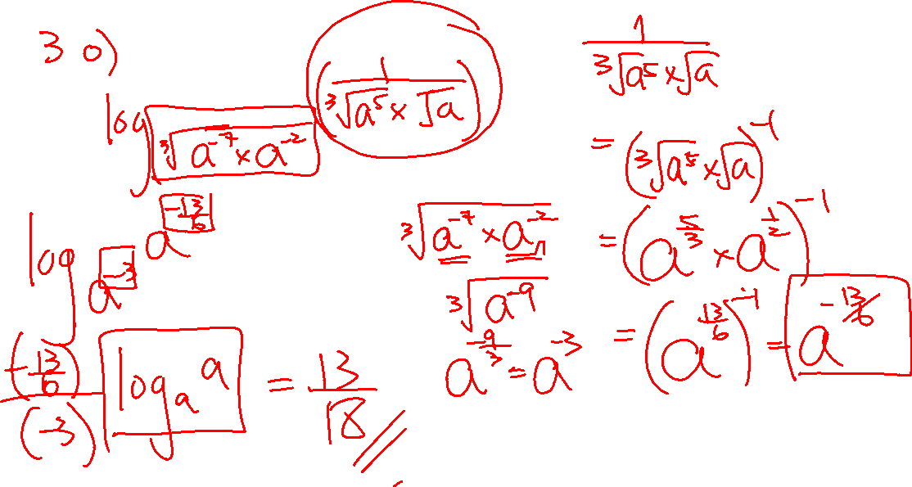

Slide 4
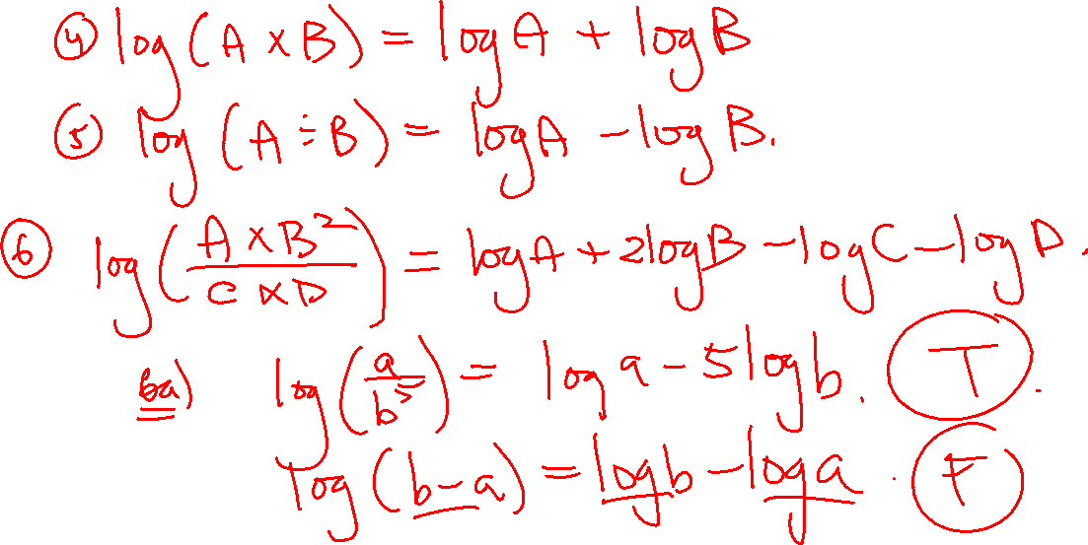

Slide 5
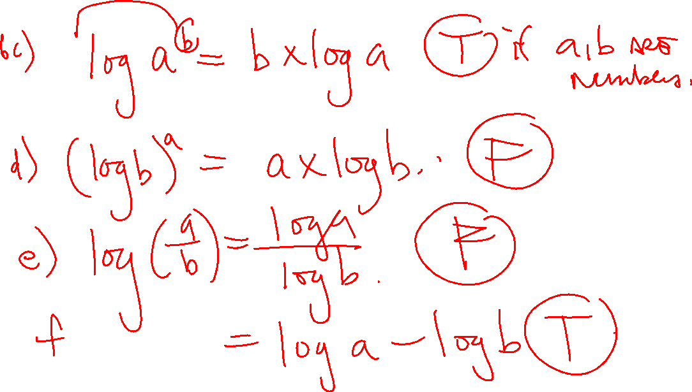

Slide 6
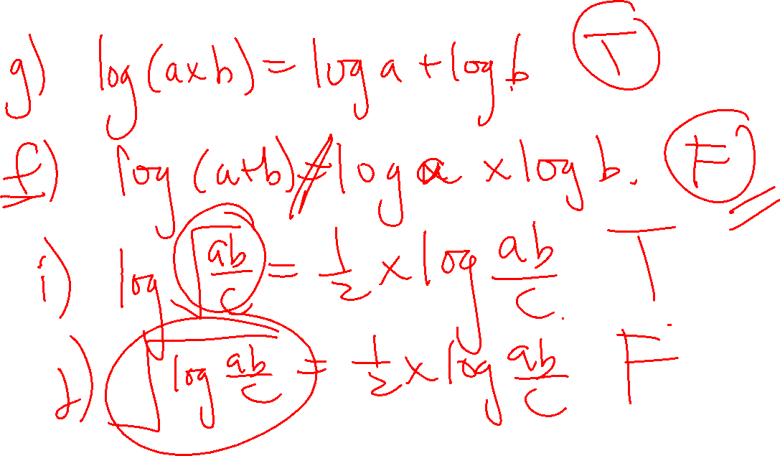

Slide 7
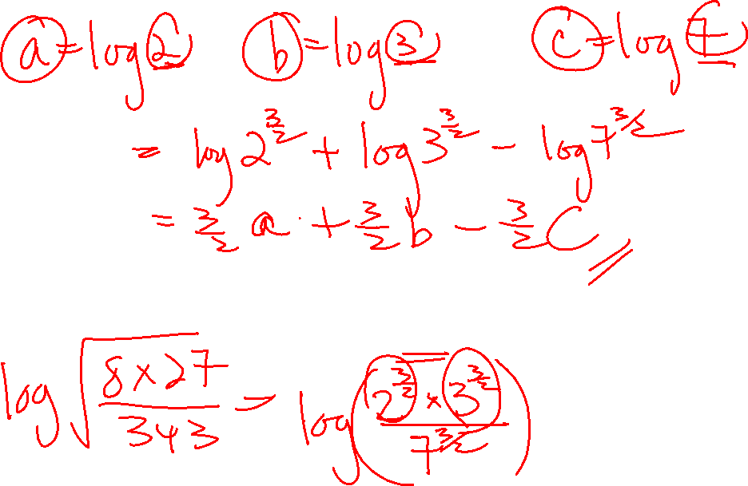

Slide 8
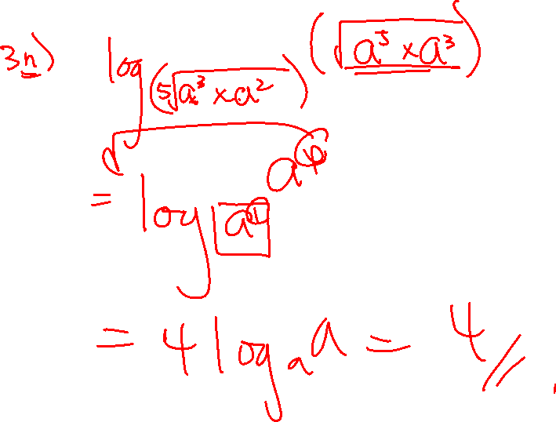


Slide 9
What is a Logarithm?
Logarithms are used for finding the exponent of a power when it’s equal to a value
Ie: Suppose you have the power below equal to 81
Exponent
Base
Number
Power
The find the value of the exponent, we use “Logarithms”
Note: Every logarithm has a base (little number)
If no base is written, then the base is “10”

Slide 10
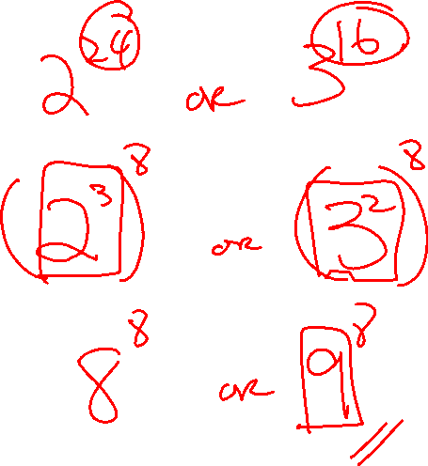

Slide 11
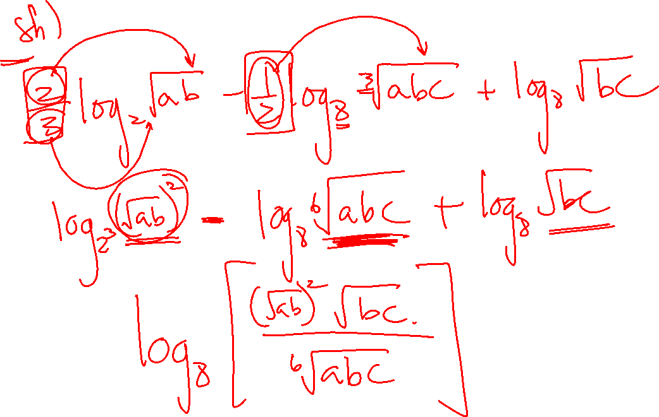

Slide 14
Practice: Find the exponent for the following

Slide 15
Basic Logs that You SHOULD KNOW
The “LOG” of an number will give you the exponent when it has a base of 10
Ie: if log 17 = 1.23044892
This means that:
© Copyright all rights reserved to Homework depot: www.BCMath.ca

Slide 16
Evaluate the following:

Slide 17
Basic Properties with Logarithms
i) You can never “LOG” a negative number
ii) The “LOG” of one is zero
iii) When no base is present, then the base is 10
Exponent
Number
Base
Exponent with
Base of 10
iv) When a base is present, then imagine it being a power with that base
Note: This is a power, so “m” will always be positive

Slide 18
Ex: Use logarithms to Solve for “X” (No calculators)
Convert the expression to Log form:
Simplify the equation first

Slide 19
Logarithm Rules: Part 2/3
If the “Base” and the “Number” have the same value
Then the “Exponent” and the “Logarithm” will be equal
“If an exponent appears in the logarithm, you can move it to the front of the logarithm and multiply them”
Note: although they are equal numerically, the graphs of the two functions below are not equal b/c their domains are different!!

Slide 20
Logarithm Rules: Part 2/3
If both the base and the term on top have an exponent, each exponent can be moved to the front as the coefficient

Slide 21
Ex: Simplify each of the following without using a calculator:

Slide 22
2nd Method:
© Copyright all rights reserved to Homework depot: www.BCMath.ca

Slide 23
© Copyright all rights reserved to Homework depot: www.BCMath.ca

Slide 24
Practice: Simplify each of the following logarithms without a Calculator:
© Copyright all rights reserved to Homework depot: www.BCMath.ca

Slide 25
Logarithm Rules: Part 3/3
Just be mindful that you don’t get these mixed up!!
Again, don’t these mixed up!!

Slide 26
This rule can be applied if the base of the power and the base of the logarithm are the same!
If the base are not the same, try to manipulate the equation so that they are equal

Slide 27
Ex: Simplify each of the following without using a calculator:

Slide 28
Ex: Simplify the following
© Copyright all rights reserved to Homework depot: www.BCMath.ca

Slide 29
Tips for Division & Multiplication Laws
Both laws can be used backwards
The sum or difference of two or more logarithms can be combined together as one log with the terms being multiplied or divided
Terms that are added will be in the numerator
Terms that are subtracted will be in the denominator
NOTE: all the Logs must have the SAME base!!
© Copyright all rights reserved to Homework depot: www.BCMath.ca

Slide 30
Ex: Simplify each of the following to a single logarithmic function:
© Copyright all rights reserved to Homework depot: www.BCMath.ca

Slide 31
Ex: Find the value for Log(x) if
© Copyright all rights reserved to Homework depot: www.BCMath.ca

Slide 32
Challenge: Given that determine in terms of “m” and “n”
Isolate Log(x) and Log (y)
Note: Both logs need to have
the same BASE!!!
© Copyright all rights reserved to Homework depot: www.BCMath.ca

Slide 33
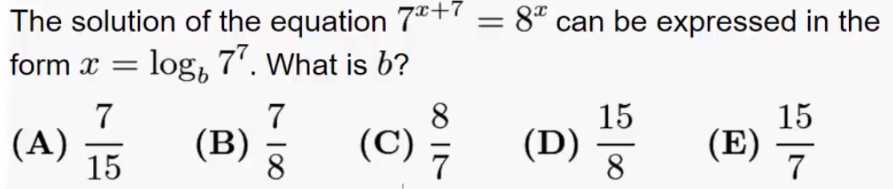

Slide 34
Proof for Power Rule:
Multiply both sides by “n”
Take both sides to the
Power of “n”
Proof for Multiplication Rule:
© Copyright all rights reserved to Homework depot: www.BCMath.ca

Slide 35
Logarithm Rules: Part 3/3
Proof:
Just be mindful that you don’t get these mixed up!!
Proof:
Again, don’t these mixed up!!
Proof:

